Slide 1
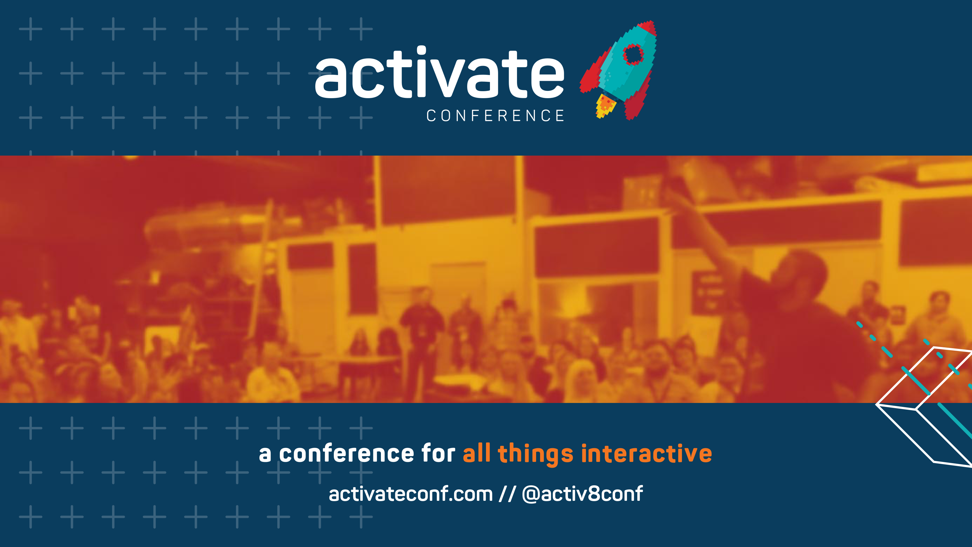
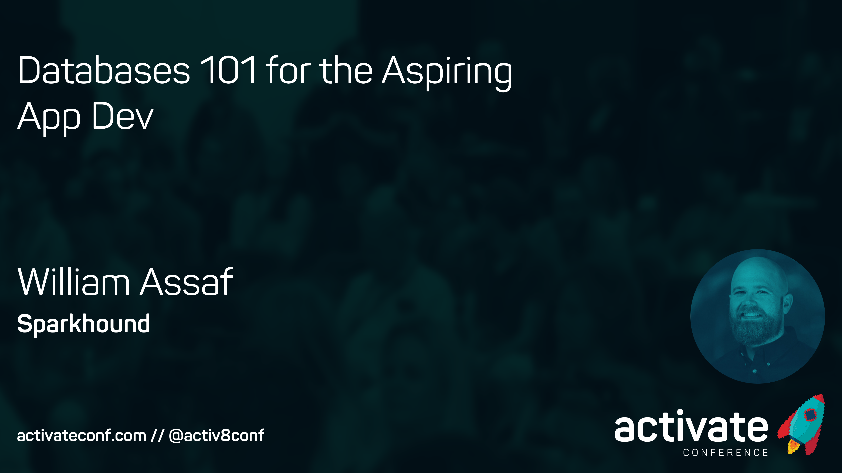
Databases 101 for the Aspiring App Dev
William Assaf

Slide 2
Databases 101 for the Aspiring App Dev
Differences between a database and other storage options
What’s NOT a database
What is a database
ACID compliant
SQL and NoSQL
SQL Language Basics
Terminology
Tables and Keys
Normalization
Live demo

Slide 3
Workshop Logistics
Ask questions! I’ll try to answer to everyone.
Scripts and slides (for both Activate presentations) are already posted on my blog at sqltact.com so that you can follow along, click these links!
On Twitter?
#activ8conf
@activ8conf and @william_a_dba

Slide 4

I Was Once
A Very
Crappy
Carpenter
Notes:
SLIDE PURPOSE: This is where everything starts – us defining with our customers how we can make an impact in their business regardless of the technology!
SPIEL: Technology should be transformative, not a to-do list. Because, really, just about any firm can change the way your IT works. Our mission is for IT to change the way your business works. The difference is a game-changer.

Slide 5
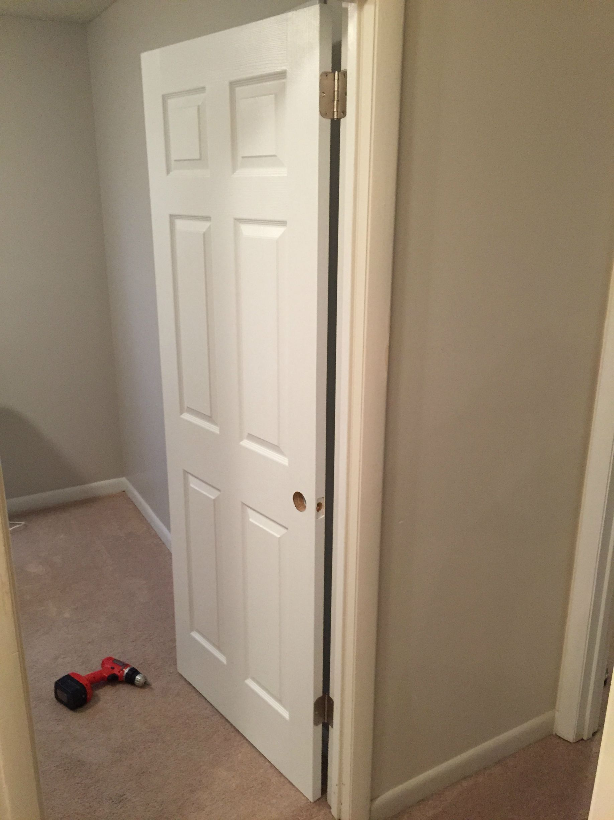
Notes:
SLIDE PURPOSE: This is where everything starts – us defining with our customers how we can make an impact in their business regardless of the technology!
SPIEL: Technology should be transformative, not a to-do list. Because, really, just about any firm can change the way your IT works. Our mission is for IT to change the way your business works. The difference is a game-changer.

Slide 6
Side projects?
Interest in my work outside?
Certification exams?
User Groups and Conferences (like this)?
Nope.
Minimum effort? Yep.
Notes:
SLIDE PURPOSE: This is where everything starts – us defining with our customers how we can make an impact in their business regardless of the technology!
SPIEL: Technology should be transformative, not a to-do list. Because, really, just about any firm can change the way your IT works. Our mission is for IT to change the way your business works. The difference is a game-changer.

Slide 7
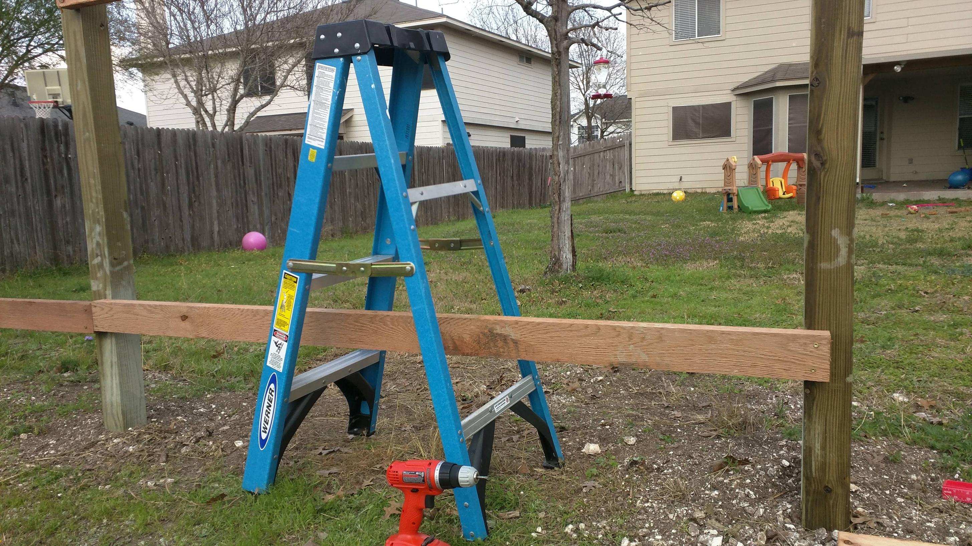
Notes:
SLIDE PURPOSE: This is where everything starts – us defining with our customers how we can make an impact in their business regardless of the technology!
SPIEL: Technology should be transformative, not a to-do list. Because, really, just about any firm can change the way your IT works. Our mission is for IT to change the way your business works. The difference is a game-changer.

Slide 8
I just did what I was told. I didn’t really try to expand or fine tune my skillset.
Those video games weren’t going to play themselves, amiright?
I was just doing the job.
And I made goofs all the time
because it was just a job.
Notes:
SLIDE PURPOSE: This is where everything starts – us defining with our customers how we can make an impact in their business regardless of the technology!
SPIEL: Technology should be transformative, not a to-do list. Because, really, just about any firm can change the way your IT works. Our mission is for IT to change the way your business works. The difference is a game-changer.

Slide 9

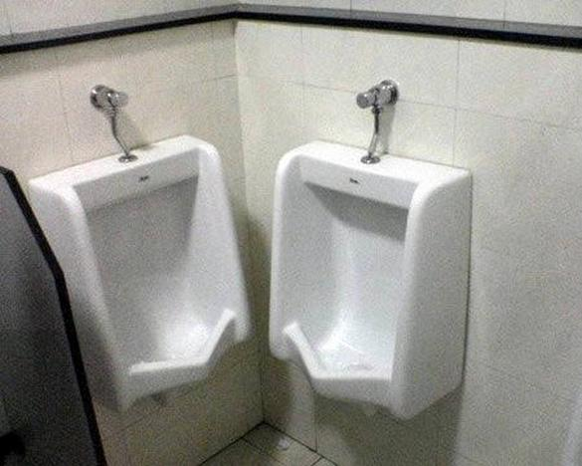
Notes:
SLIDE PURPOSE: This is where everything starts – us defining with our customers how we can make an impact in their business regardless of the technology!
SPIEL: Technology should be transformative, not a to-do list. Because, really, just about any firm can change the way your IT works. Our mission is for IT to change the way your business works. The difference is a game-changer.

Slide 10
I just wasn’t very good.
I wanted be a better carpenter, I really did…
but couldn’t find time to make myself into one.
That was my employer’s responsibility...
…right?
Notes:
SLIDE PURPOSE: This is where everything starts – us defining with our customers how we can make an impact in their business regardless of the technology!
SPIEL: Technology should be transformative, not a to-do list. Because, really, just about any firm can change the way your IT works. Our mission is for IT to change the way your business works. The difference is a game-changer.

Slide 11
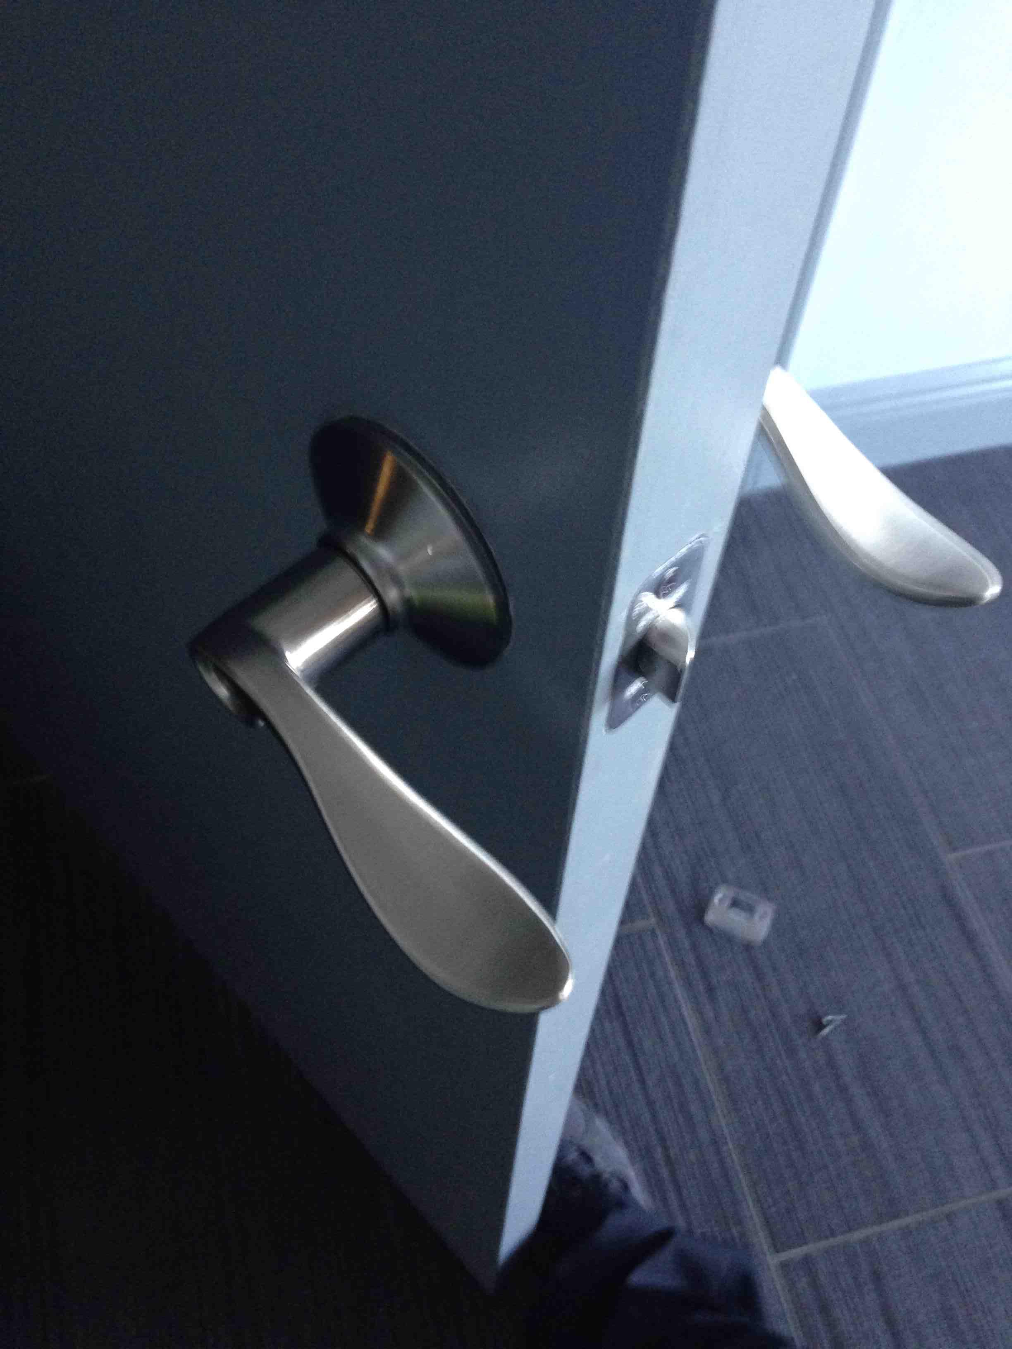
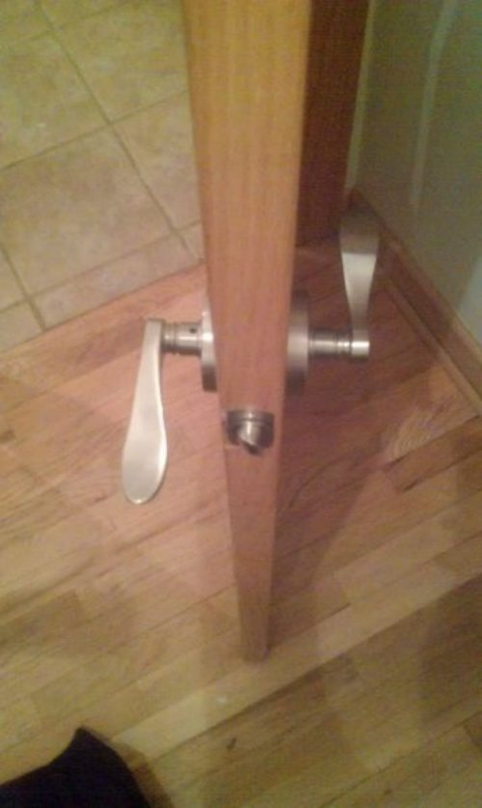
Notes:
SLIDE PURPOSE: This is where everything starts – us defining with our customers how we can make an impact in their business regardless of the technology!
SPIEL: Technology should be transformative, not a to-do list. Because, really, just about any firm can change the way your IT works. Our mission is for IT to change the way your business works. The difference is a game-changer.

Slide 12
Sometimes what we want to be
and what we do at work every day
aren’t the same thing.
Whose problem is that?
Notes:
SLIDE PURPOSE: This is where everything starts – us defining with our customers how we can make an impact in their business regardless of the technology!
SPIEL: Technology should be transformative, not a to-do list. Because, really, just about any firm can change the way your IT works. Our mission is for IT to change the way your business works. The difference is a game-changer.

Slide 13
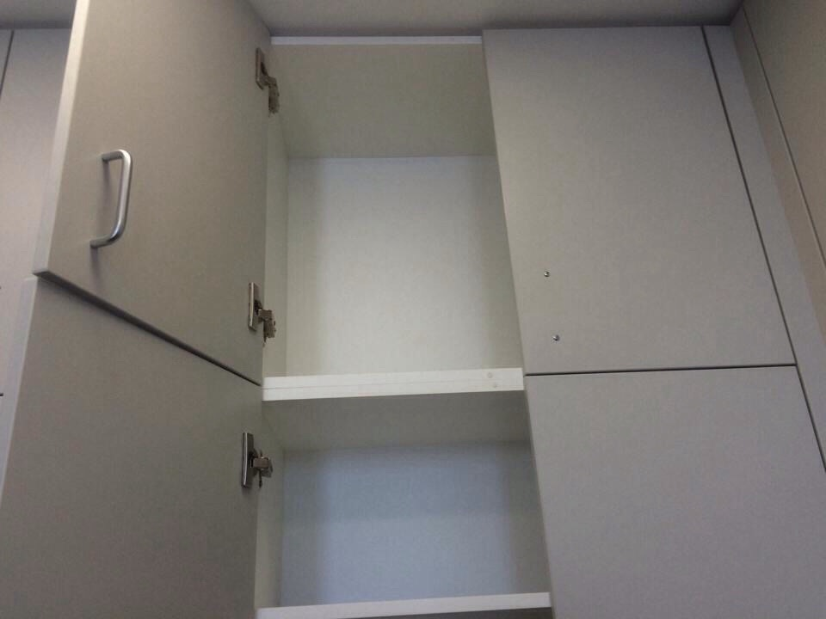

Notes:
SLIDE PURPOSE: This is where everything starts – us defining with our customers how we can make an impact in their business regardless of the technology!
SPIEL: Technology should be transformative, not a to-do list. Because, really, just about any firm can change the way your IT works. Our mission is for IT to change the way your business works. The difference is a game-changer.

Slide 14
So I started studying on my own time.
I showed interest, paid more attention.
I stopped pointing out roadblocks, and started developing solutions.
I started attending local User Groups and events.
I created my own related side projects, even if no one ever knew about them.
I passed an cert exam. It was tough!
And THEN I got into a good work situation with experience around me.
Notes:
SLIDE PURPOSE: This is where everything starts – us defining with our customers how we can make an impact in their business regardless of the technology!
SPIEL: Technology should be transformative, not a to-do list. Because, really, just about any firm can change the way your IT works. Our mission is for IT to change the way your business works. The difference is a game-changer.

Slide 15
I started learning again.
Did I make mistakes? Sure.
But I was on the path.
Notes:
SLIDE PURPOSE: This is where everything starts – us defining with our customers how we can make an impact in their business regardless of the technology!
SPIEL: Technology should be transformative, not a to-do list. Because, really, just about any firm can change the way your IT works. Our mission is for IT to change the way your business works. The difference is a game-changer.

Slide 16

Notes:
SLIDE PURPOSE: This is where everything starts – us defining with our customers how we can make an impact in their business regardless of the technology!
SPIEL: Technology should be transformative, not a to-do list. Because, really, just about any firm can change the way your IT works. Our mission is for IT to change the way your business works. The difference is a game-changer.

Slide 17
You are not [going to be] a good carpenter
if your own house isn’t full of the tools of your trade and your own projects.
The only way to learn is to do.
Don’t expect to learn everything from your school or employer or this presentation.
Notes:
SLIDE PURPOSE: This is where everything starts – us defining with our customers how we can make an impact in their business regardless of the technology!
SPIEL: Technology should be transformative, not a to-do list. Because, really, just about any firm can change the way your IT works. Our mission is for IT to change the way your business works. The difference is a game-changer.

Slide 18

Join SQL PASS (sqlpass.org) or the .NET Foundation and other local user groups and other tech organizations for your field
(BRSSUG.org has links to many)
Go to stuff like this conference Hey congrats, you’re already here!
See you at SQLSaturday in August!
All this stuff is really good for professional networking!

Slide 19
Write a blog post explaining a topic in your field, even if it beginner-level, even if nobody reads it
Give a 10-15 min Lightning Round talk to your local user group
Give a lunch and learn at your office
Give a 60 presentation to your local user group
Give a presentation at SQLSaturday or Tech Fest or Activ8 Conference!

Slide 20
Also:
Get organized. Keeping getting more organized than you were before. Take notes in OneNote or Keep or something, not on paper.
Get a task list, calendar, etc.
The method and idea needs to be YOURS.
Stop fearing being wrong, start fearing becoming obsolete. Stay technical!
Learn to admit when you’re wrong, and stop wasting time covering it up.

Slide 21
Also:
3. Think you understand something? Find out.
Try blogging about it, or speaking about it.
4. Have a can-do attitude.
Don’t be a fault-finder.
Don’t think of roadblocks as a default method of contributing to discussion.
Start treating your fellow students, coworkers, and colleagues in the community like friends, not like assets or competition or frenemies.

Slide 22
Also:
Never pass up an opportunity to give a sincere "Great job!“ or praise
Never ask a woman if she is pregnant.
Never ask a woman if she is a “booth babe”.
Don’t hate.
Caffeinate. Activate!

Slide 23
Ready?

Slide 24

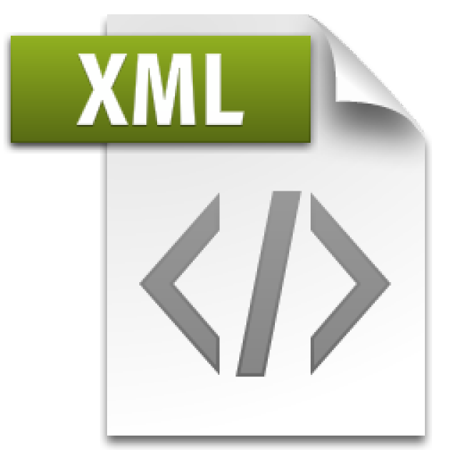

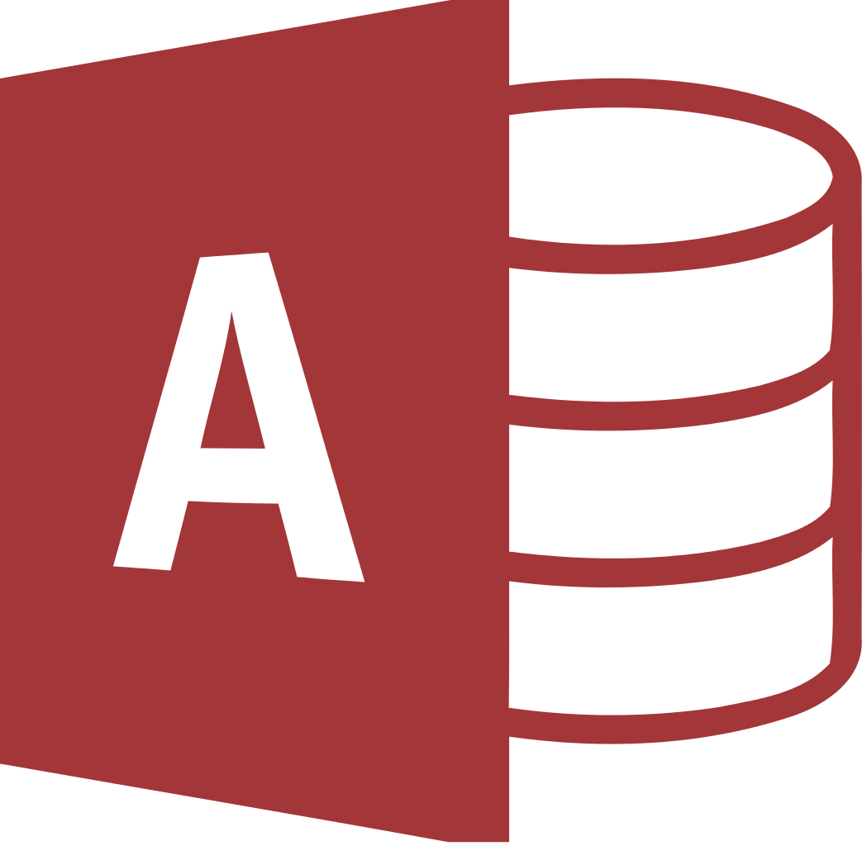
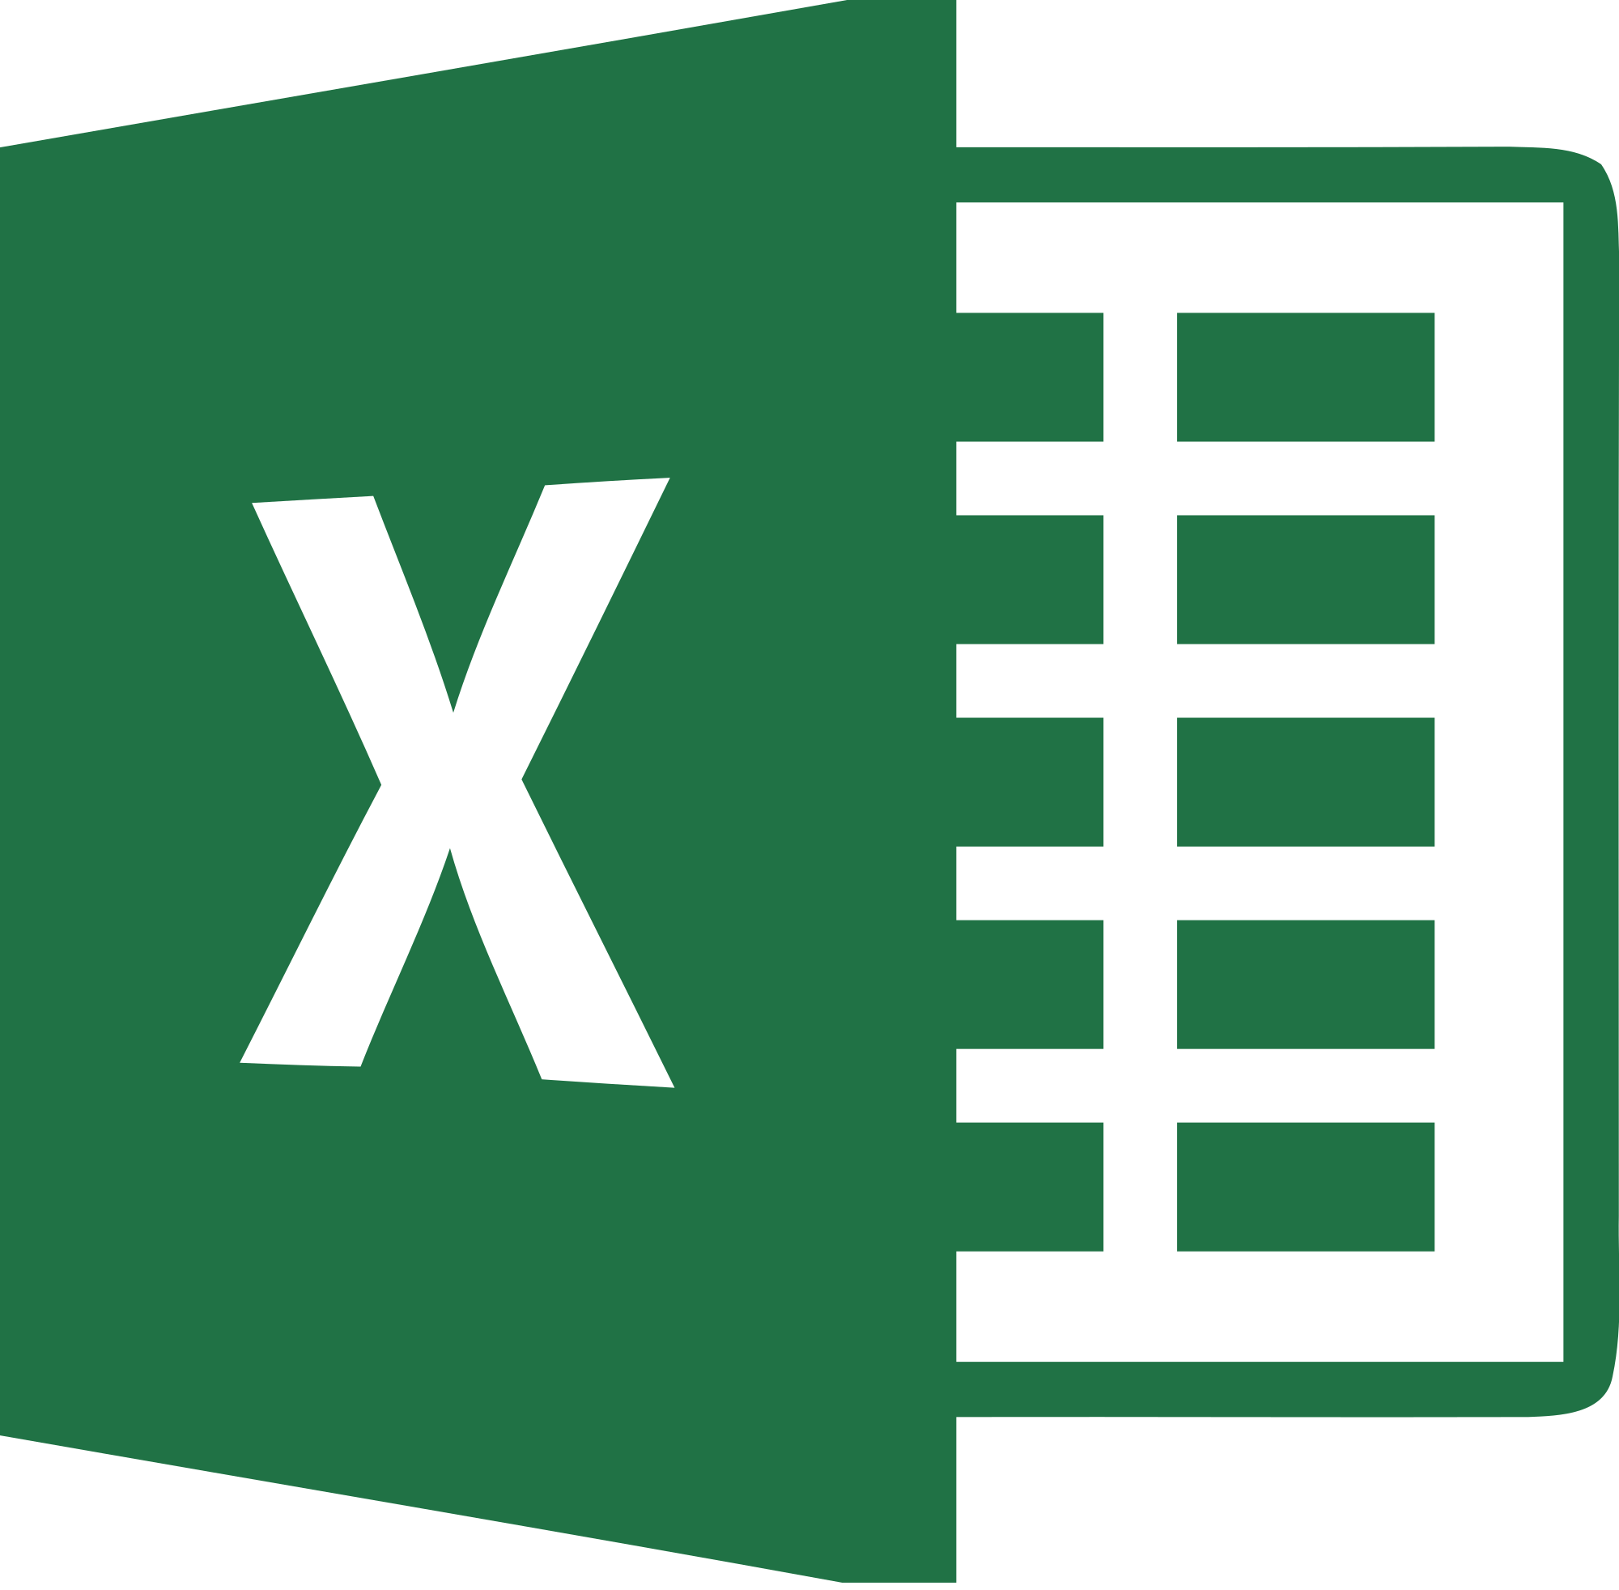
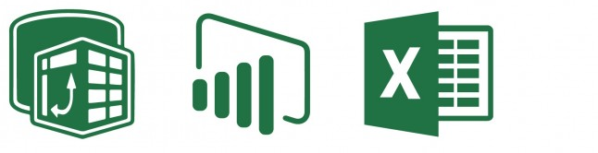
What’s Not a Database
Flat files
Including json and xml
Azure Table storage
Microsoft Access databases
Not designed for Concurrency, limited, more of a RAD tool
Excel - most popular BI tool in the world
There are dangers of "silo'ing" data
The Excel, PowerPivot, PowerBI stack
Though, valuable tools for self-service business intelligence
But not a database!

Slide 25
What’s Not a Database
Things that are NOT databases may do just fine:
Store data for retrieval, even querying, by a user
Have data appended (but not updated)
Maybe even have some optional structure around data types
Things that are NOT databases are not designed for:
Typed data validation
Transactional processing, isolated updates
Disaster Recovery / High Availability
Concurrency (multiple users)
Corruption Detection
Much more…

Slide 26
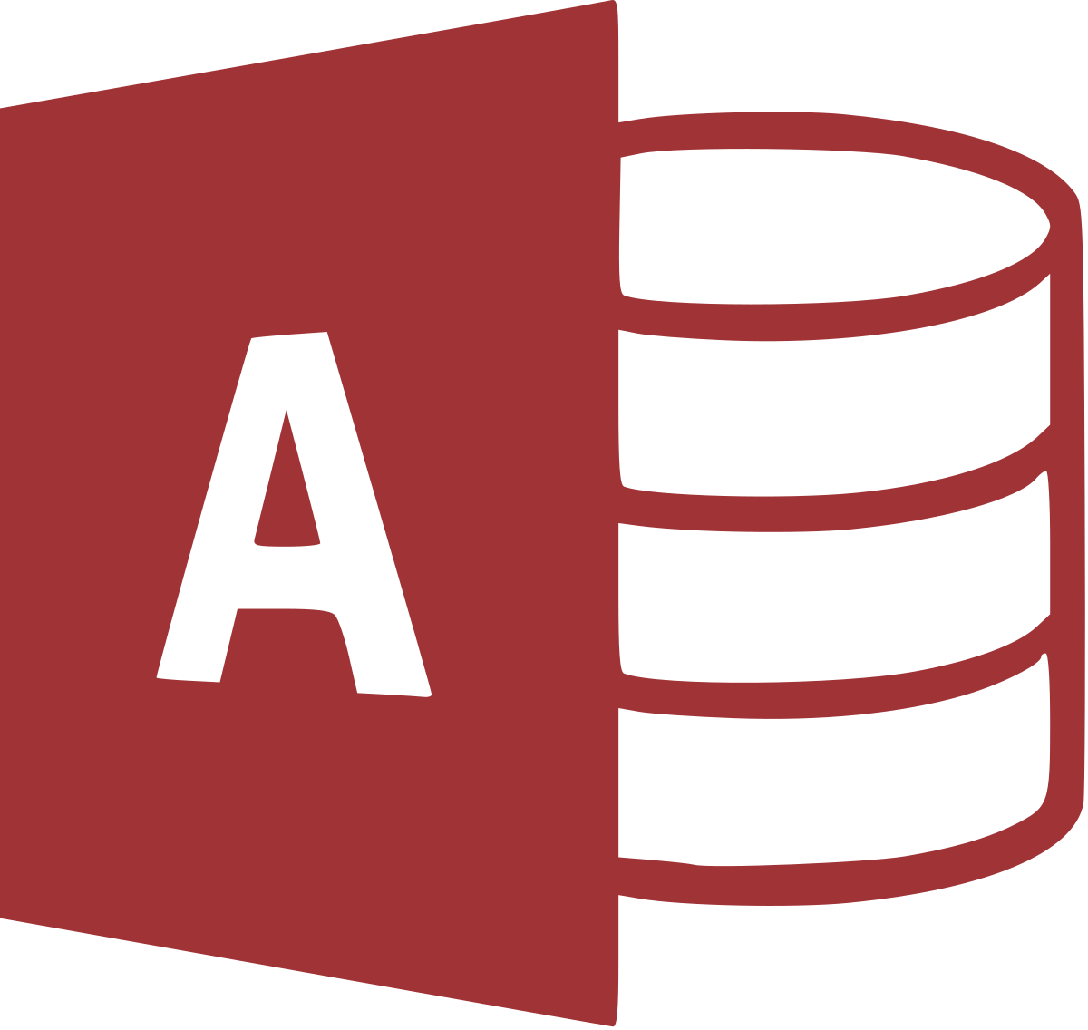
MS Access is a “Database Simulator”
Microsoft Access documentation is full of caveats about the lack of concurrency and scalability for Access.
The 32-bit "Microsoft Jet [the database engine inside Access] can only handle a limited number of sessions."
"...when multiple concurrent users make requests of a Microsoft Access database, unpredictable results may occur."
"...it was not intended (or architected) for high-stress performance..."
Appropriate as a front end ONLY. Store your data in a DB!

Slide 27
What is a Database
Products like Microsoft SQL Server (and Azure SQL DB)
Competitors: Oracle, MySQL, PostgreSQL, IBM DB2, SQLite
All follow some implementation of a universally accepted standard language for data platforms:
SQL – “Structured Query Language”
SELECT … FROM … WHERE …
Microsoft’s implementation = TSQL
Oracles implementation = PLSQL
Basics are same, but many important vendor-specific features are nonstandard, not interchangeable, require cross-training

Slide 28
SQL
“Structured Query Language”
“Sequel” not “Ess Que Ell”
“SQL Server” is the name specifically for the Microsoft database platform

Slide 29
ACID Compliant Databases
Atomic
A transaction is all or nothing, must commit or rollback completely
Consistent
Transaction brings the entire database from one state to another - not just a single part of the database
Eventual consistency can be useful - Cassandra, MongoDB, Redis
Isolated
Transactions, though handled concurrently, are still processed sequentially and independently
Incomplete transactions should not be visible to other transactions
Durable
If the power goes off, the data is still there. It's not stored in volatile memory.

Slide 30
NoSQL
NoSQL isn’t a product, it’s a category, similar to “big data”
Big data storage: Apache Hadoop, Azure Blob Storage, Spark
NoSQL platform examples: Azure CosmosDB, MongoDB, Amazon DynamoDB, Gremlin, Google Firebase
Many are document-based, storing “rows” as JSON, and “tables” as a collection of snippets
Many will argue that NoSQL isn’t a database, but just fancier doc storage with an API on top

Slide 31
NoSQL
One of the commonly used characteristics of a NoSQL platform is eventual consistency.
Twitter cannot commit a transaction globally, synchronously
Your hot taek tweet takes some time to globally propagate through the distributed system
Other aspects of ACID may be violated in name of performance. As long as the devs are aware, it’s OK.

Slide 32
When to use NoSQL?
SQL solutions were generally designed for single-server architectures, but this is not the rule. Sharded or partitioned architectures are possible, but are not as easy or simple.
Microsoft Azure CosmosDB can create multimaster partitions at any Azure Datacenter in the world with the click of a button
While Microsoft SQL Server multimaster architectures are complex, secondary read-only replicas are straightforward
Because of the above, rapid/hyper scaling with SQL solutions can be more complex than with NoSQL

Slide 33
When to use NoSQL?
Unstructured data is a common use case for NoSQL, but you can accomplish this storage efficiently with a SQL database
SQL databases can store blobs, json documents, xml documents natively, in-row with other relational metadata.
This is a common SQL Server pattern for health care data (HL7) and credit reports, for example, which have a huge complex schema, only a small portion of which is populated

Slide 34
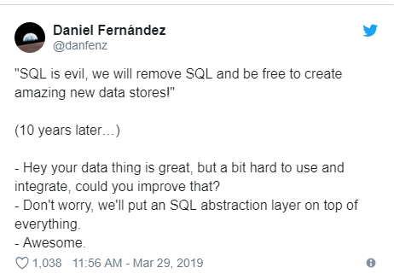
When not to use NoSQL?
Don’t decide to use a NoSQL platform just based on your desired one-row read/write functionality.
You need to consider your eventual aggregate/analytical read functionality.
To search, analyze, calculate, aggregate across ranges of rows in a NoSQL platform, it must be extracted and transformed (even if this is done behind the scenes).

Slide 35
When not to use NoSQL?
Don’t use NoSQL as your primary data platform just to avoid things like data types, foreign keys, constraints, etc.
Don’t use NoSQL just because you’re “open source”.
Don’t use NoSQL just to be “agile”
Don’t use NoSQL just because you don’t know what your data looks like yet

Slide 36
When not to use NoSQL?
NoSQL data be extracted and transformed, even if in memory, for efficient analytical querying and reporting
Often NoSQL solutions must be packaged with a separate product for analytical/aggregate reporting consumption
MongoDB’s Enterprise BI connector serves up BI via a MySQL database… a SQL solution built-in to a NoSQL platform.

Slide 37
When to use SQL?
Eventual Consistency completely unacceptable for some large databases, especially if time sensitive. These run on SQL Server
NASDAQ
The world’s largest sportsbook (Bwin)
Many large online platforms are designed and run SQL Server:
Stackoverflow
Dell
FOX Sports mobile app

Slide 38
Like Peanut Butter and Jelly
In reality, in your application environment, there could be good use cases for both SQL and NoSQL platforms that properly use the strengths of each.
Some example use cases that may co-exist in an enterprise:
SQL database
OnLine Transactional processing (OLTP) of data, complex transactions
Master data management, reference for external integration API’s
Reporting, foundation for other analytical systems (OLAP)
Querying and joining across from multiple systems
NoSQL platform
Imports from rapidly-changing or complex external data
IoT or streamed data massive-scale writes (aka a Data Lake)
Continuously, procedurally-modified schemas
Anticipated need for extreme growth and geographic replicas

Slide 39
Microsoft NoSQL offerings
CosmosDB is a planet-scale database platform that has multiple API’s, allowing it to walk/talk like MongoDB, SQL, Gremlin, more
PolyBase is a feature inside MS SQL to query big data in Hadoop or Azure Blobs with TSQL.
Many different MS SQL Server features allow breaking ACID for performance by developers.

Slide 40
Some Terminology
OLTP (OnLine Transactional Processing) read/write systems, highly important transactions, usually with few rows each
OLAP (OnLine Analytical Processing) Read-only systems for massive aggregation, statistical analysis, rolling aggregations, year-over-year comparison, trending, predictive

Slide 41
Some Terminology
Normalized, Relational (RDBMS), Normal Form, OLTP Many tables contain structured data with rules for integrity Good for writes, transactions, distinct lists for dropdowns,
De-normalized, Flattened, Flat File Just one table contains all the data in very wide rows Good for simple reporting, extracts to heterogenous systems
Dimensional, Data Cube, Star Schema, OLAP Many tables contain data formatted for massive reads Good for complex reporting, pre-calculated aggregation

Slide 42
SQL Server Infrastructure
Very rarely do I ever see a physical machine with SQL Server installed.
Almost always, we deal with Virtual Machines (VM’s) running on VMWare or Hyper-V.
Old myth that SQL doesn’t run well in a VM.
Many are hosted in corporate data centers. Many more are hosted in regional data centers (like nearby Venyu) or larger data centers run by Microsoft, Amazon, etc.
As of 2017, Microsoft SQL Server runs on Windows or various Linux distributions

Slide 43
PaaS Revolution
MS SQL Server is installed, configured, maintained
What if there was an offering that provided everything for you, automated, without maint?
Platform-as-a-Service
An instance of a database is created for you, with easy UI to interact, no maintenance, backups, storage config needed
Scalable – change CPU/memory/storage capacity on the fly
Examples: Azure SQL DB, Amazon RDS
Infrastructure-as-a-Service
Here’s a VM. Have fun. But you don’t have to worry about the network layer, redundant power, physical disks. Also scalable.

Slide 44
The Future
In the near future, application stacks from the web front end (WFE) all the way down to the data platform will be “containerized”.
We won’t talk much about this today, but containers are the future and you should keep an eye out. Learn about Kubernetes, Docker.

Slide 45
From Here Out
We’ve talked a lot about SQL vs NoSQL solutions.
From here out, we’re going to focus on SQL solutions, though not specifically Microsoft SQL Server when I can help it.

Slide 46
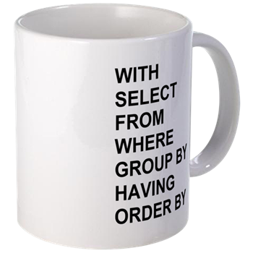
Basics of SQL
WITH
SELECT
FROM
WHERE
GROUP BY
HAVING
ORDER BY;

Slide 47
Basics of SQL
WITH
SELECT – what column(s)
FROM – from what table(s)
WHERE – with what filter(s)
GROUP BY
HAVING
ORDER BY – in what order;

Slide 48
Basics of SQL
WITH – use a CTE
SELECT – what column(s)
FROM – from what table(s)
WHERE – with what filter(s)
GROUP BY – aggregate by these
HAVING – filter the aggregates
ORDER BY – in what order;

Slide 49
SQL Examples
Toolbox: lab - TSQL 101.sql Link: https://github.com/williamadba/Public-Presentations
This syntax in these samples is simple enough that it should work with no/minimal alteration in any ANSI SQL-compliant database platform.

Slide 50
How to get MS SQL Server - Editions
This is the link to download SQL for FREE:
Do a web search: SQL Server 2017 Downloads, click Developer
Free editions: Developer (good), Express (bad!)
Developer is same as Enterprise, but cannot be used in production
Express despite being free is not exactly production ready – it can’t back itself up, needs external solution
Standard edition is not free, but roughly 20% the $ of Enterprise

Slide 51
How to get MS SQL Server free Sample DB
Microsoft also publishes a full-featured sample database:
WideWorldImporters: WideWorldImporters-Full.bak (restores to any SQL Server Edition aside from LocalDB)

Slide 52
How to get MS SQL Server - Tools
The tools to dev in the Microsoft ecosystem are all free, just do a web search:
SSMS (for SQL Server)
SSDT (for SSRS, SSIS, SSAS) (installs shell of Visual Studio if not found)
Visual Studio Community Edition or Visual Studio Code

Slide 53
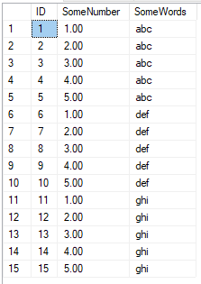
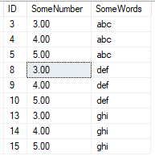
Basics of SQL
--Not best practice
--Use Schema.objectname
--Semicolon please!
Better:
SELECT ID, SomeNumber, SomeWords
FROM dbo.SomeTable
WHERE SomeNumber > 2;
Let’s say I only want all columns from this table, but only the rows where
SomeNumber > 2
Works:
SELECT *
FROM SomeTable
WHERE SomeNumber > 2

Slide 54
Comments
Yes, you should comment your SQL.
--comment the rest of this line
/*
Comment a whole block of text
*/

Slide 55
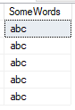
Basics of SQL
I only want SomeWords that begin with ‘a’
Works:
SELECT SomeWords
FROM dbo.SomeTable
WHERE SomeWords like 'a%'
Also works:
SELECT SomeWords
FROM dbo.SomeTable
WHERE LEFT(SomeWords, 1) = 'a'
Lots of different string manipulation functions:
https://docs.microsoft.com/en-us/sql/t-sql/functions/string-functions-transact-sql

Slide 56
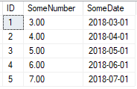
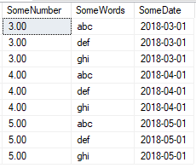
Basics of SQL
I have another table with SomeNumber.
But second table has important dates. I need to join the two tables on SomeNumber, and display data only where I find a match.
Works:
SELECT SomeTable.SomeNumber, SomeWords, SomeDate
FROM dbo.SomeTable INNER JOIN dbo.SomeTable2
ON SomeTable.SomeNumber = SomeTable2.SomeNumber
ORDER BY SomeTable.SomeNumber;
SELECT SomeTable.SomeNumber, SomeWords, SomeDate
FROM dbo.SomeTable --No table aliases INNER JOIN dbo.SomeTable2
ON SomeTable.SomeNumber = SomeTable2.SomeNumber
ORDER BY SomeTable.SomeNumber;
--No table aliases
Better:
SELECT t1.SomeNumber, t1.SomeWords, t2.SomeDate
FROM dbo.SomeTable AS t1
INNER JOIN dbo.SomeTable2 AS t2
ON t1.SomeNumber = t2.SomeNumber
ORDER BY t1.SomeNumber, t1.SomeWords, t2.SomeDate;

Slide 57

Joins
Source: https://www.codeproject.com/Articles/33052/Visual-Representation-of-SQL-Joins

Slide 58
Flatten Tables vs Normalized Tables
Flattened/De-Normalized
To express 1-to-Many relationships, must grow horizontally by adding columns (this is bad)
No good for OLTP, can be useful for reporting
Inefficient to add/provide distinct type attributes
Normalized
Deduplicates data, enforces business logic
Helps identify and store complex relationships
Express 1-to-Many relationships by adding rows (this is good, programmatic)

Slide 59

Flatten Tables vs Normalized Tables
In normalized database design, there is no TWO. There is one, or many.
How many phone numbers to store?
How many email addresses to store?
How many accounts can someone have?
Design your tables to store either one, or many things.
Never have columns PHONENUMBER1, PHONENUMBER2, PHONENUMBER3… etc.

Slide 60
Normalized Table Design
Academic study of Normal Forms
3NF (Third Normal Form) is most common and realistic
Important to identify in almost every table:
Primary Key
Unique Key
Foreign Key
Natural Key
Surrogate Key

Slide 61
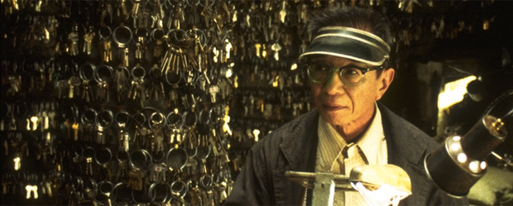
Let’s talk about Keys
Primary Key
Identify parent relationships to other tables
Unique Key
Identify uniqueness(es), can have more than one
Foreign Key
Identify this column as a child to another table
Natural Key
Business-generated key
Surrogate Key
System-generated key

Slide 62
Keys
Primary Key
Identify parent relationships to other tables
Unique Key
Identify uniqueness(es), can have more than one
Foreign Key
Identify this column as a child to another table
Natural Key
Business-generated key
Surrogate Key
System-generated key
Often these keys are on the same column, when we create an IDENTITY (autoincrement) column.
Also commonly serves as the Key to clustered index.

Slide 63
Keys
Primary Key
Identify parent relationships to other tables
Unique Key
Identify uniqueness(es), can have more than one
Foreign Key
Identify this column as a child to another table
Natural Key
Business-generated key
Surrogate Key
System-generated key
These two keys MUST NOT be the same!
Users should never see Surrogate Keys, and Surrogate Keys should never change.
Users should only see Natural keys, and can therefore change these values.

Slide 64
Keys
Primary Key
Identify parent relationships to other tables
Unique Key
Identify uniqueness(es), can have more than one
Foreign Key
Identify this column as a child to another table
Natural Key
Business-generated key
Surrogate Key
System-generated key
Primary Keys are always unique, but you can also have more than one Unique Key. You can have a Primary Key on an IDENTITY field, and also enforce uniqueness on one or more other columns.

Slide 65
Keys
Primary Key
Identify parent relationships to other tables
Unique Key
Identify uniqueness(es), can have more than one
Foreign Key
Identify this column as a child to another table
Natural Key
Business-generated key
Surrogate Key
System-generated key
Foreign Keys reference the Primary Key of another table.

Slide 66
Keys
Primary Key
Identify parent relationships to other tables
Unique Key
Identify uniqueness(es), can have more than one
Foreign Key
Identify this column as a child to another table
Natural Key
Business-generated key
Surrogate Key
System-generated key
Surrogate Keys are the best choice for PK’s, because they can never change, and so they can never cause a cascading update through FK’s.

Slide 67
Normalization Antipatterns
Bad (one table)
Student
NAME(key)_PHONE1_PHONE2_PHONE3_PHONE4…
Good (three tables):
Student
ID(key)_NAME
StudentPhone
ID(key)_StudentID_PhoneNum_PhoneTypeID
PhoneType
ID(key)_TYPE

Slide 68
Normalization Antipatterns
Bad (one table)
Student
NAME(key)_PHONE1_PHONE2_PHONE3_PHONE4…
B Smith 2255555555 2254444444 2253333333 NULL
J Smith 2255555555 2254444444 NULL NULL
K Smith 2255555555 2254444444 2251111111 2259999999
Good (three tables): Student
ID(key)_Name
StudentPhone 1 B Smith
ID(key)_StudentID_PhoneNum_PhoneTypeID 2 J Smith
1 1 2255555555 1 3 K Smith
2 1 2254444444 1
3 1 2253333333 2 PhoneType
4 2 2255555555 1 ID(key)_Type
5 2 2254444444 2 1 Mobile
6 3 2255555555 1 2 Home
7 ….

Slide 69
Normalization Exercise
We’ll use a whiteboard or SSMS’s built-in database diagram designer to design a normalized table structure.
What hobbies do we have?
What do we know the business logic well?

Slide 70
Accessing your SQL Server
Now that it is installed, how do you log in to it?
During install, you’re given a chance to:
Add initial administrators. Use your domain account (if applicable) or local windows user, or a Windows/AD security group that you are in.
If you activate SQL Authentication, provide a password for the ‘sa’ login.
Heads up – avoid using ‘sa’ whenever possible, especially not in your apps!!
Use Windows Auth whenever possible.

Slide 71
Logins vs Users
Database User
Set a database context
Linked to a Server Login
Does not have a password
Assigned to Database Roles
Stored in the User Database
Brought along with a User DB Restore
Given access to SELECT, ALTER, EXECUTE, CREATE TABLE
Server Login
Connect to a SQL Server
Can be linked to AD (Windows)
Can have a password (SQL)
Assigned to Server Roles
Stored in the Master database
Not affected by User DB Restore
Given access to BACKUP, RESTORE, CONNECT, CREATE DATABASE

Slide 72
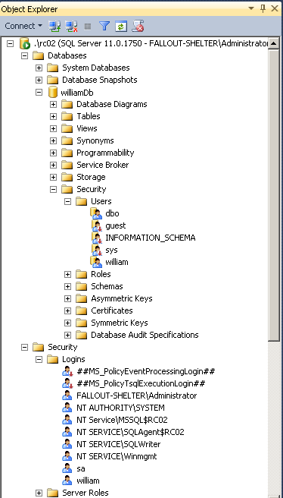
Database User
Set a database context
Linked to a Server Login
Does not have a password
Assigned to Database Roles
Stored in the User Database
Brought along with a User DB Restore
Server Login
Connect to a SQL Server
Can be linked to AD (Windows Login)
Can have a password (SQL Login)
Assigned to Server Roles
Stored in the Master database
Not affected by User DB Restore

Slide 73
Server Logins
A Server Login is a server-level security principal.
Logins are given a default database. CONNECT will fail if the Default Database is no longer present or accessible.
Just use tempdb as the default database for admins.
In order to access data in a database, must be linked to a Database User.

Slide 74
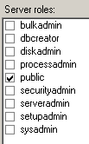
Server Login Roles
Server Logins are most commonly added to Server Roles, which are self-explanatory and well documented.

Slide 75
Windows Auth vs SQL Auth
In a domain environment,
AD authentication means that
account creation/termination,
security group membership,
password policy,
are handled by an existing corporate security administration infrastructure.

Slide 76
Windows Auth vs SQL Auth
Windows Authentication is the default security model for SQL Server and cannot be disabled.
Enable “Mixed Mode” to allow for SQL Logins
Choosing Mixed Mode as a server option enables SQL Logins and allows the “sa” account to be enabled.

Slide 77
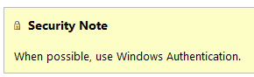
SQL Auth
SQL Logins are authenticated by SQL Server.
Strongly encouraged to Enforce password policy, which can include password expiration.
Multiple failed SQL auth login attempts will Lock Out.

Slide 78
Database Users
A Database User is a database level security principal.
A Database User can be linked to any Login (Windows or SQL Auth) – and the names don’t actually have to match.
Database Users have a sid, such as 0xE5EFF2DB1688C246855B013148882E75
which is shared by the linked Server Login.

Slide 79
SQL Auth Logins
SQL Auth Logins can become disconnected from their Database Users when a database is restored from another server.
This isn’t a problem with Windows Authenticated logins.
To re-associate a database user to a server login:
ALTER USER username WITH LOGIN = loginname;

Slide 80
MS SQL File Basics
Even for the databases you have locally on your development machine, DR things you need to know:
Each SQL Server database has at least
one data file (.mdf)
one transaction log file (.ldf)
The transaction log file contains any write or alteration
The data file will grow as you add data
The log file will grow as you add or modify data

Slide 81
MS SQL Backup Basics
Three types of backups for a SQL Server
Full
Start of any recovery chain
Differential
Based on a full
Transaction Log (behaves like an incremental)
Log backups are the most critical for you to understand.
They form a chain, starting with a Full or Differential
Taking a log backup empties the transaction log file (the .ldf)
This is extremely important to understand!

Slide 82
Database Recovery Model and the Transaction Log
Simple
Transactions are quickly, automatically cleared from Log
No Log backups
No Point in Time Recovery (Full/Diff backups only)
Appropriate for DEV/TEST , or read-only/nighty reporting DB’s
Full
Transactions stay in Log until truncated
Log backups taken regularly –or– Log will grow unchecked!
Point in Time recovery is possible and desirable
Appropriate for PROD

Slide 83
Database Recovery Model
So what recovery model is appropriate for your local development databases or pre-production databases?
SIMPLE
What recovery model is appropriate for your Production databases?
FULL
And then you scheduled Transaction Log backups every hour
Guidance: No less frequently than every hour.
Any less frequent and you’re missing the point

Slide 84

The Microsoft SQL Server Transaction Log
Windows sees
1GB file
SQL sees
1GB reservation
with ~1GB free
Windows sees
1GB file
SQL has used up the space, the file must grow
Transactions
+10%
Transactions
+10%
Transactions
Windows sees
1.1GB file
SQL sees
1GB reservation
with ~.1GB free
Windows sees
1.21GB file
SQL sees
1.1GB reservation
with ~.11GB free
Transactions
Transactions
Transactions
Transactions
.LDF file

Slide 85
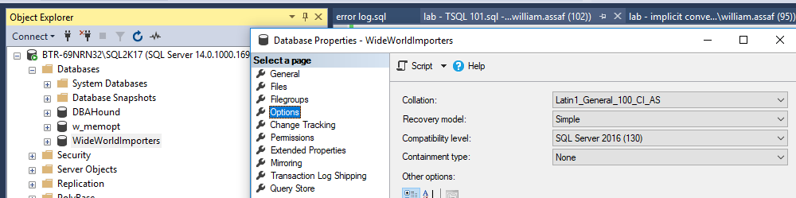
Database Recovery Model
In SQL Server Management Studio:

Slide 86
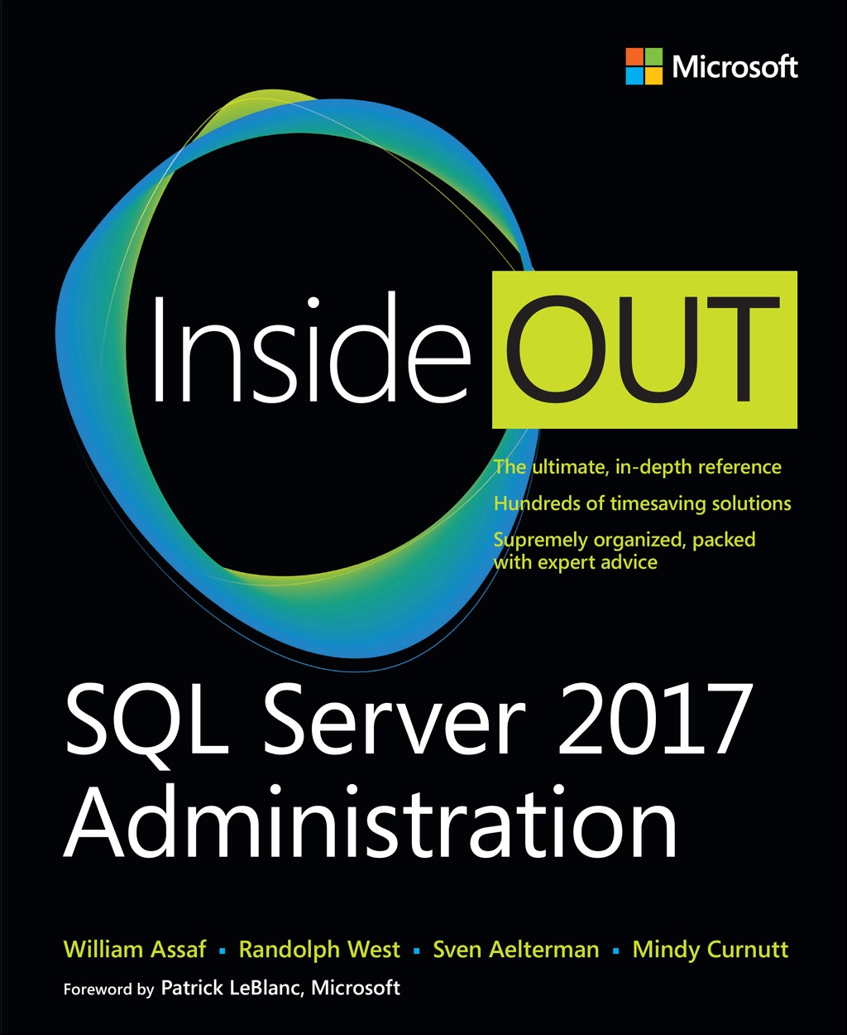
SQL Server 2017 Administration Inside Out
Published Feb 19, 2018 by Microsoft Press
2nd edition for SQL 2019 coming Q4’2019*
*just a guess

Slide 87

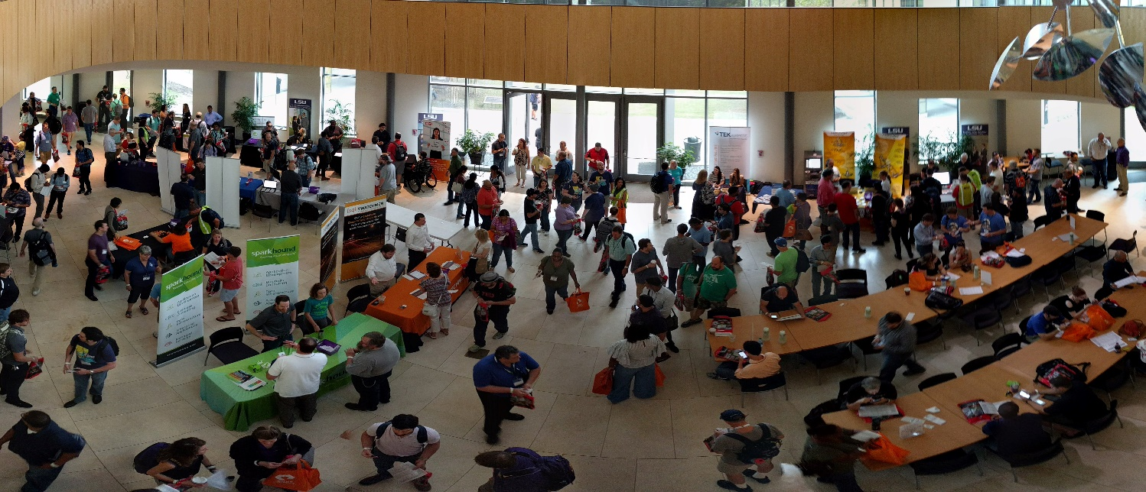
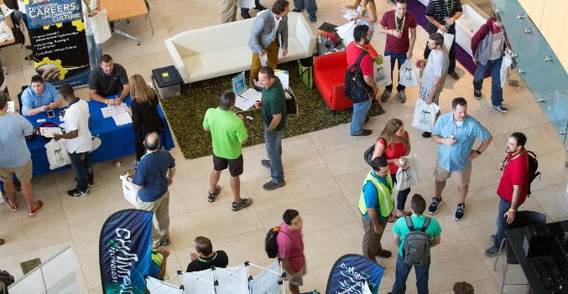
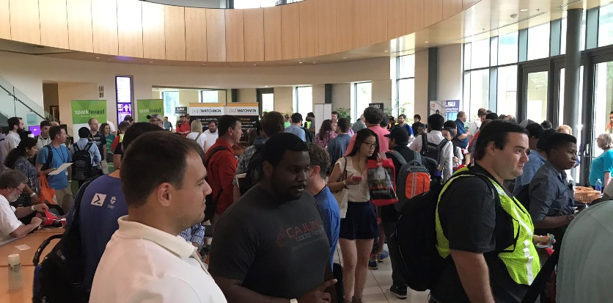

Free SQL Server, .NET, Business Intelligence training and more!
An all day FREE training event with SQL Server and Development related sessions spread out over multiple tracks of Business Intelligence, SQL Development,
Database Administration, IT Pro, .NET,
Career Development, and CIO/IT Management
See you August 17 at
SQLSatBR.com

Slide 88
Bio and contact
William D Assaf, MCSE
Baton Rouge SQL Server UG board and SQLSaturday chair
Principal Consultant, Manager – DBA Team at
Sparkhound Inc. in Baton Rouge
William.Assaf@sparkhound.com
Twitter: @william_a_dba
This presentation, including all source code and this slide deck, has been posted at my blog:
SQLTact.com

